Slide 1
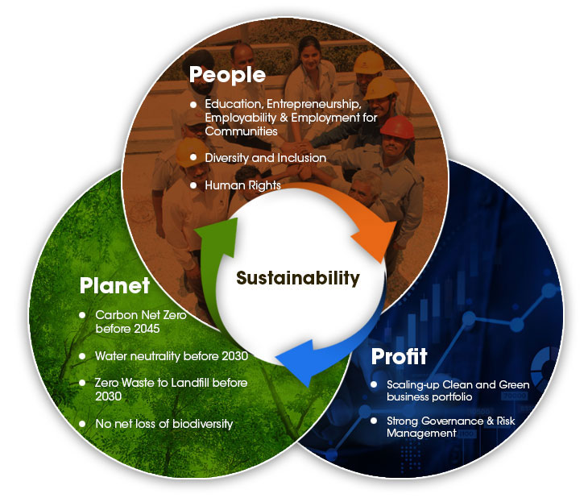
Tata sustainability solutions
Whether it's measuring progress on your sustainability efforts, automating and scaling them, or de-risking your investments, our comprehensive set of solutions can help.
We have over 200 offerings that help meet your sustainability goals.
12/04/2021

Slide 2
Fitment matrix of opportunities and solutions
Build resilience and grow sustainably, successfully navigating economic and environmental disruption.
Nurture future generations by building a more inclusive and secure planet, providing access to knowledge and resources to improve the quality of life.
Facilitate sustainable and inclusive economic growth and social mobility.
12/04/2021

Slide 3
Opening slide – design option Add slide title here
DUU Proposition: Tata Sustainability Solutions
 | iON | Circle4Life | Clever Energy | Zero carbon platform | ESG integration solutions
Sustainable building
climate adaptation and resilience
Emissions and carbon neutrality
energy consumption
water consumption.

